Slide 1
Exploring the 1000 Genomes Project GENE360: tutorial 4
A/Prof Mik Black
Department of Biochemistry University of Otago

Slide 2
Overview
1000 Genomes Project
Inception & initial results (pilot)
Phase 1 and 3
Fringe benefits
Methodology
Data
Additional topics
Population diversity and Admixture
Human disease

Slide 3
1000 Genomes Project
http://www.1000genomes.org
International collaboration
Detailed catalogue of human variation
Pilot launched Jan 2008 (180 samples, 3 populations)
2500 genomes, 26 populations (main phase: 2009-2015)
Funding
Wellcome Trust Sanger Institute
Beijing Genomics Institute
National Human Genome Research Institute
In 2015 the International Genome Sample Resource (IGSR) was established to ensure the ongoing data access.

Slide 4

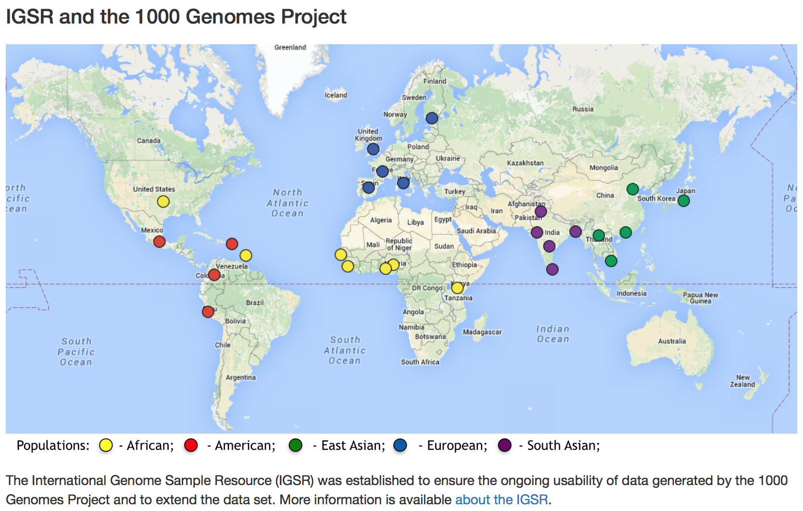
http://www.1000genomes.org/

Slide 5
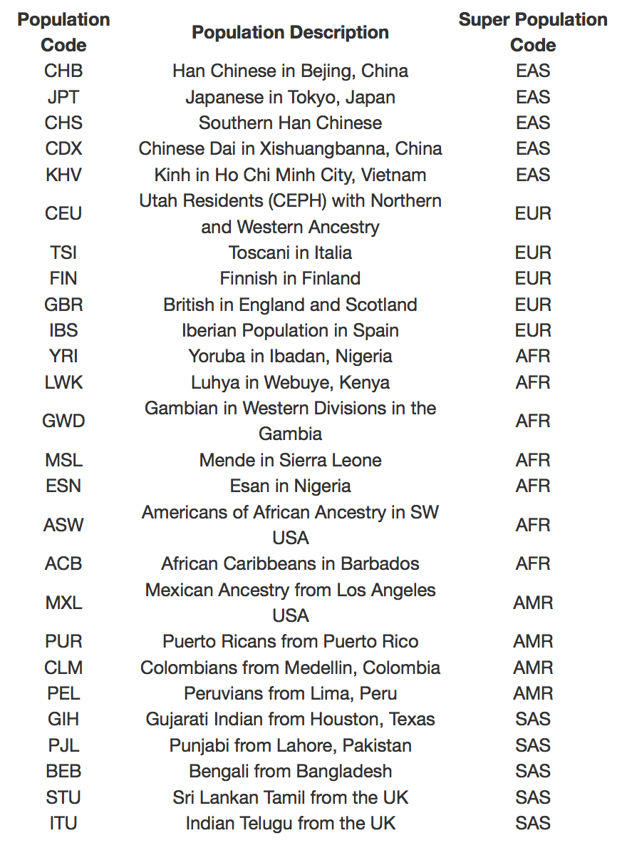
26 populations
5 super-populations
EAS (East Asian)
EUR (European)
AFR (African)
AMR (American)
SAS (South Asian)
Roughly 100 individuals per population
http://www.1000genomes.org/

Slide 6
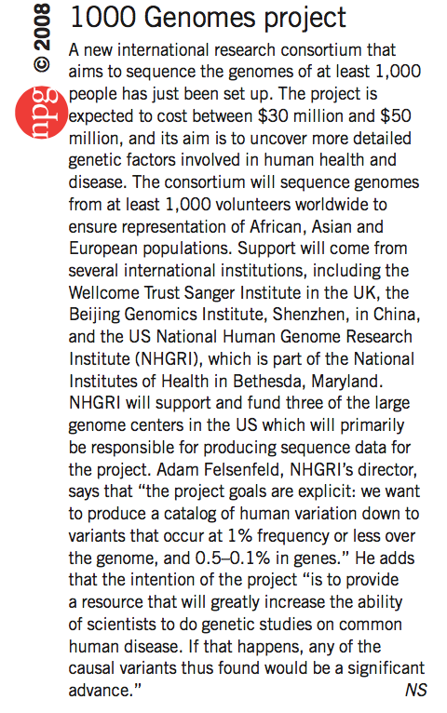


Slide 7

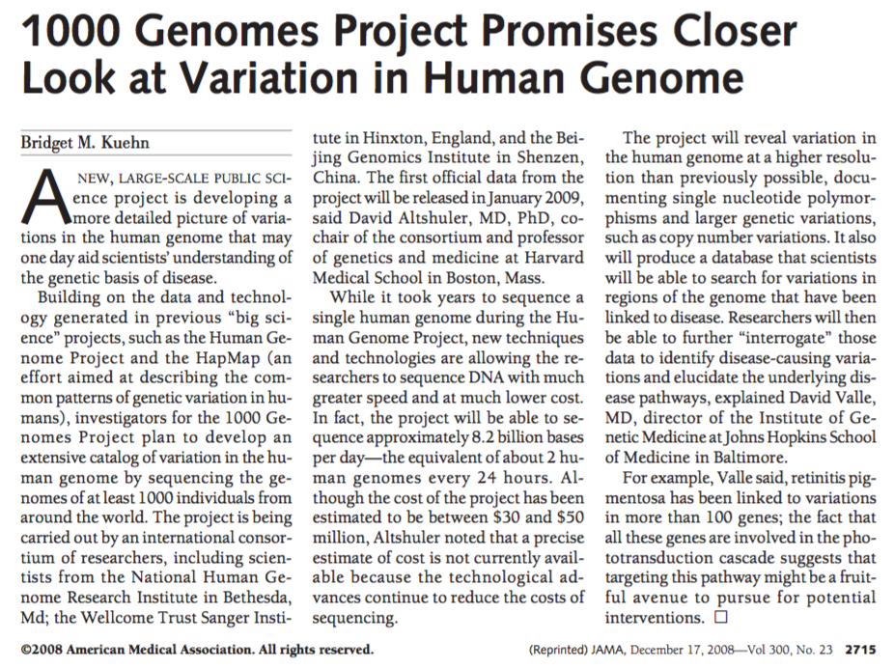

Slide 8
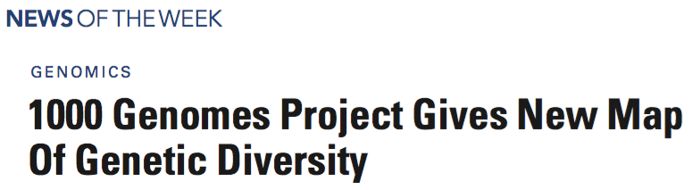
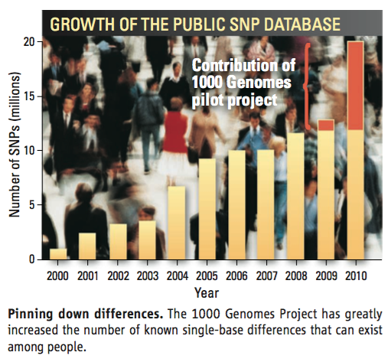

Slide 9
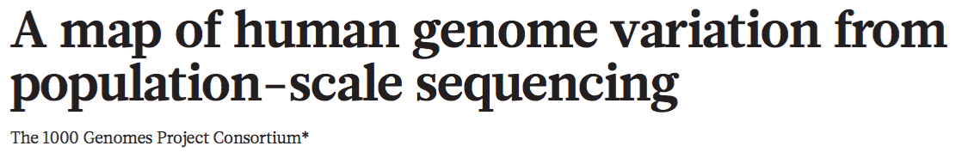

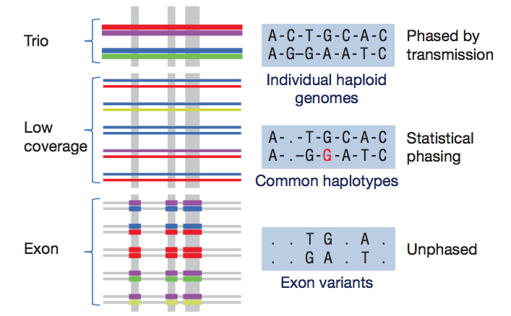
Pilot (low coverage)
4 populations
CEU: 60
YRI: 59
CHB: 30
JPT: 30

Slide 10
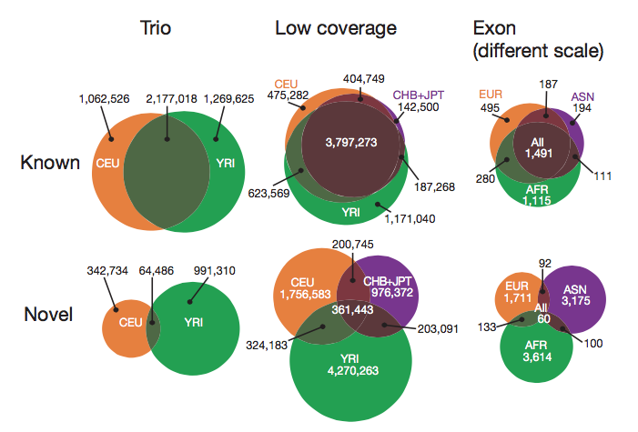

Slide 11
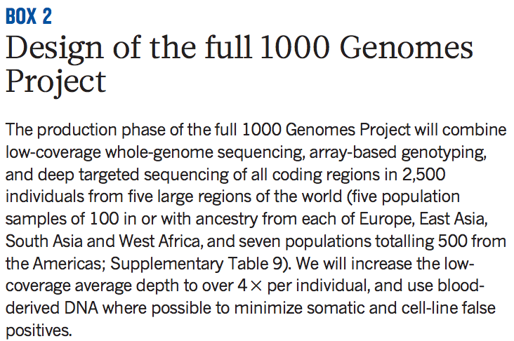

Slide 12
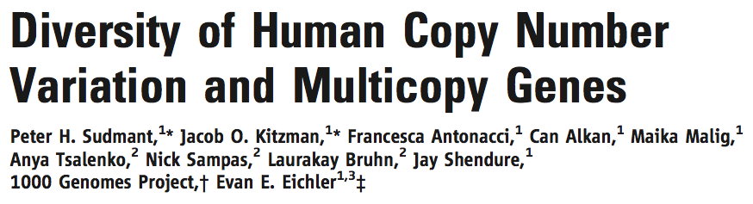
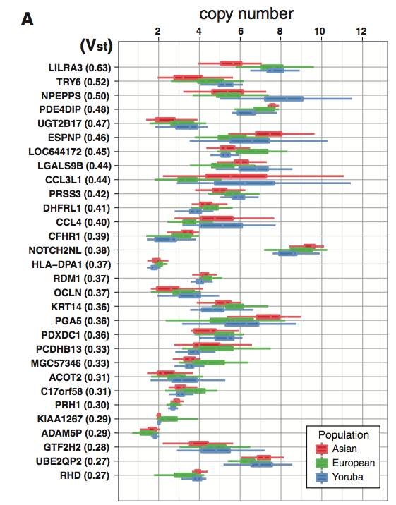
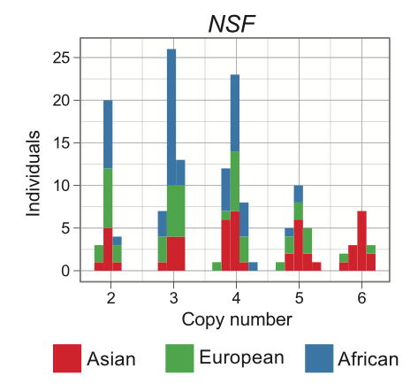

Slide 13
Fringe benefits
The 1000 Genomes Project has been hugely beneficial for bioinformatics
Standardized data formats
Improved mapping and variant calling algorithms
Access to large amounts of genotype data
Protocols developed for storage, management and sharing of large data sets
Also taught us A LOT about sequence data, and the characteristics of different sequencing technologies.

Slide 14
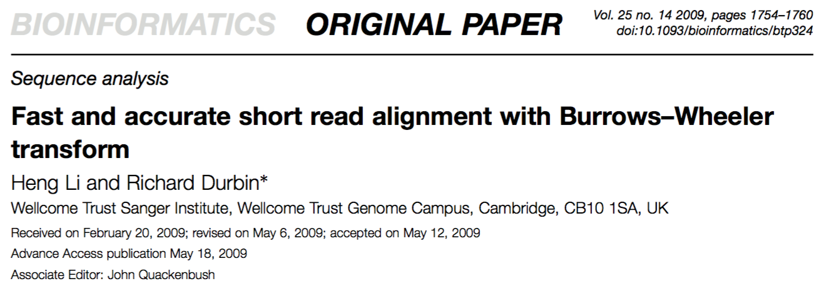
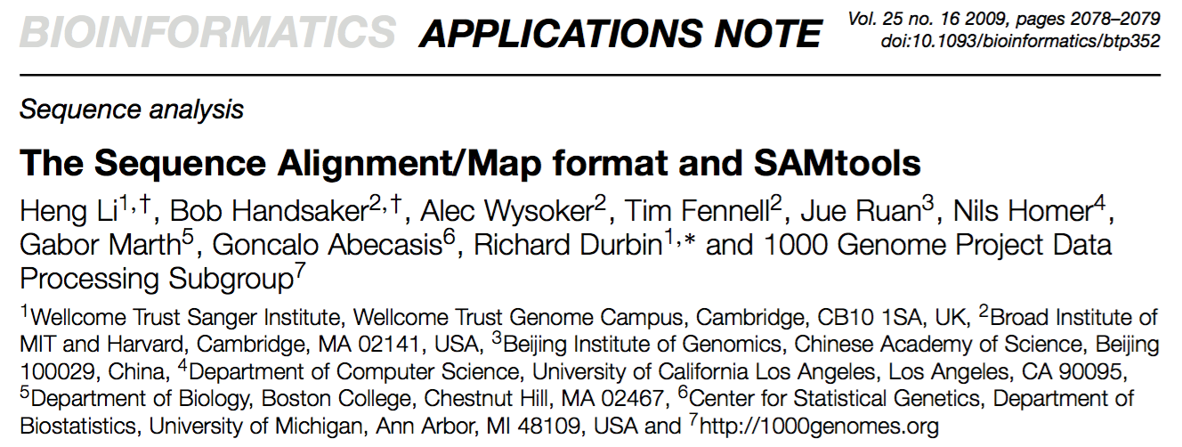
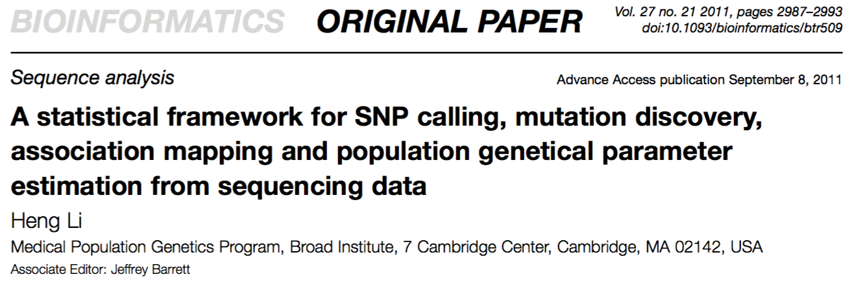

Slide 15
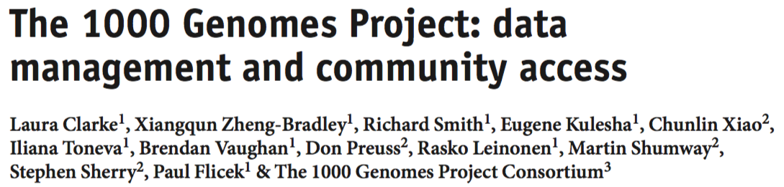
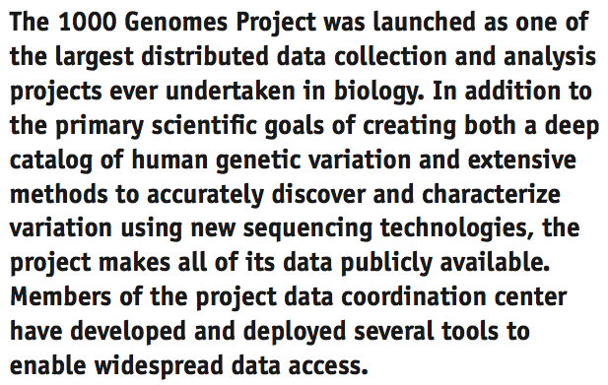

Slide 16
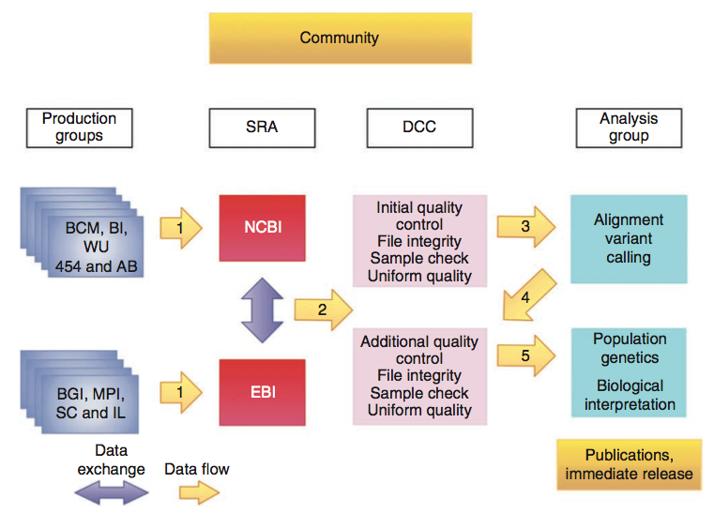

Slide 17
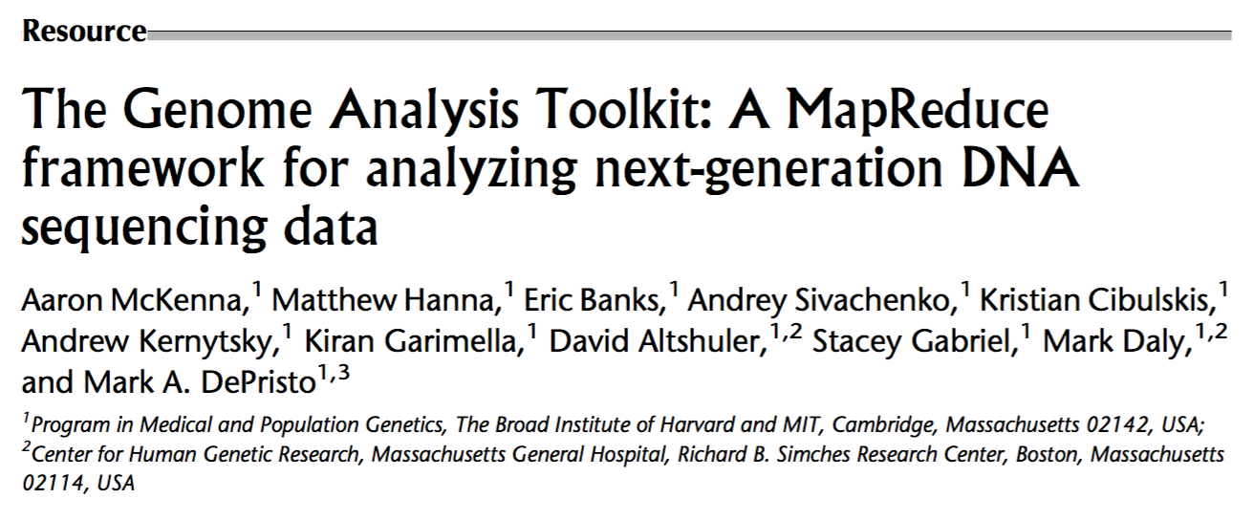
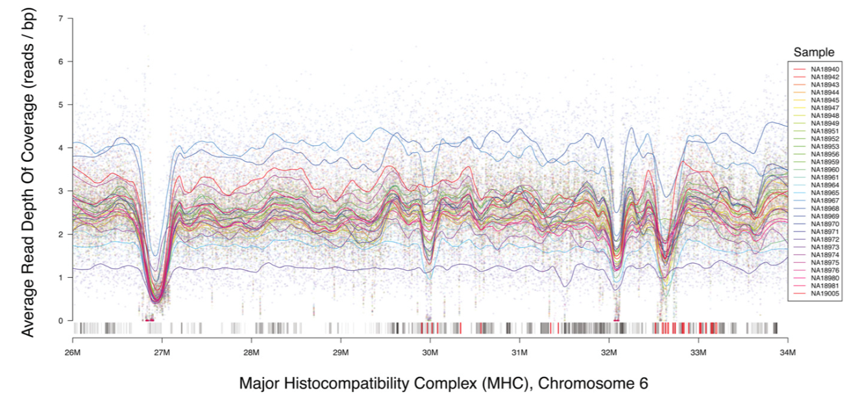
Notes:
Just shows output of depth of coverage walker in GATK. Coverage drops in regions with high density of HLA genes (red in bottom track). Why? They don’t say… (seq similarity?)

Slide 18
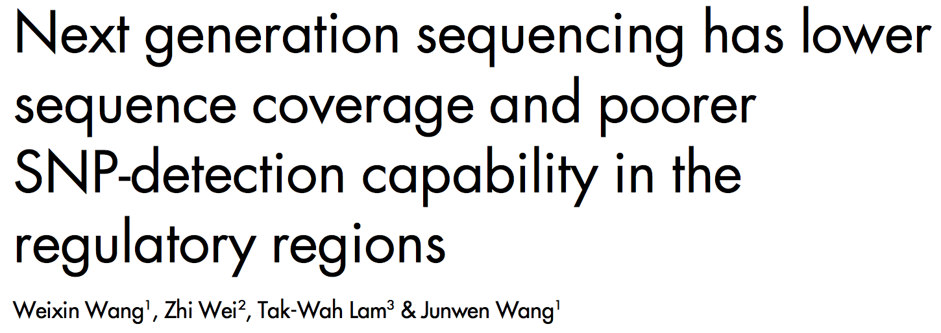
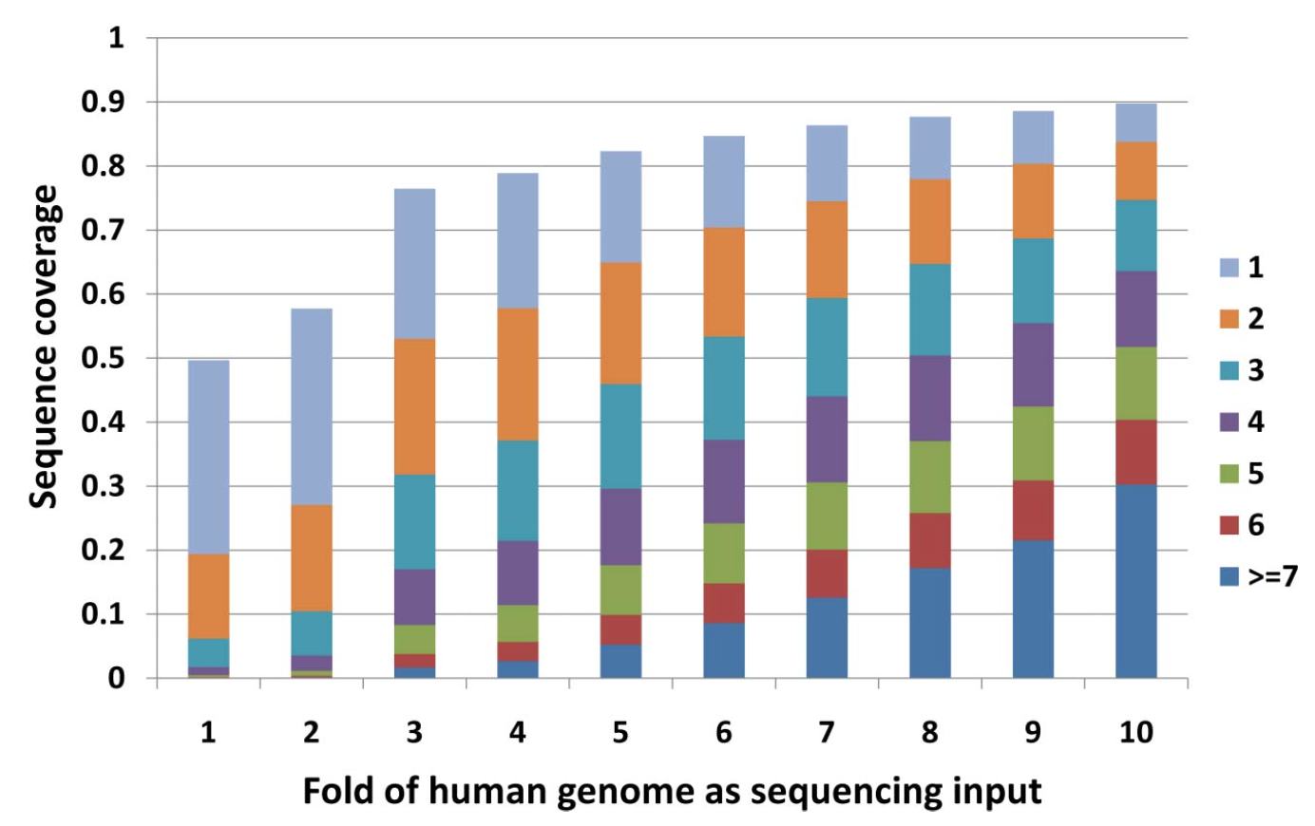

Slide 19
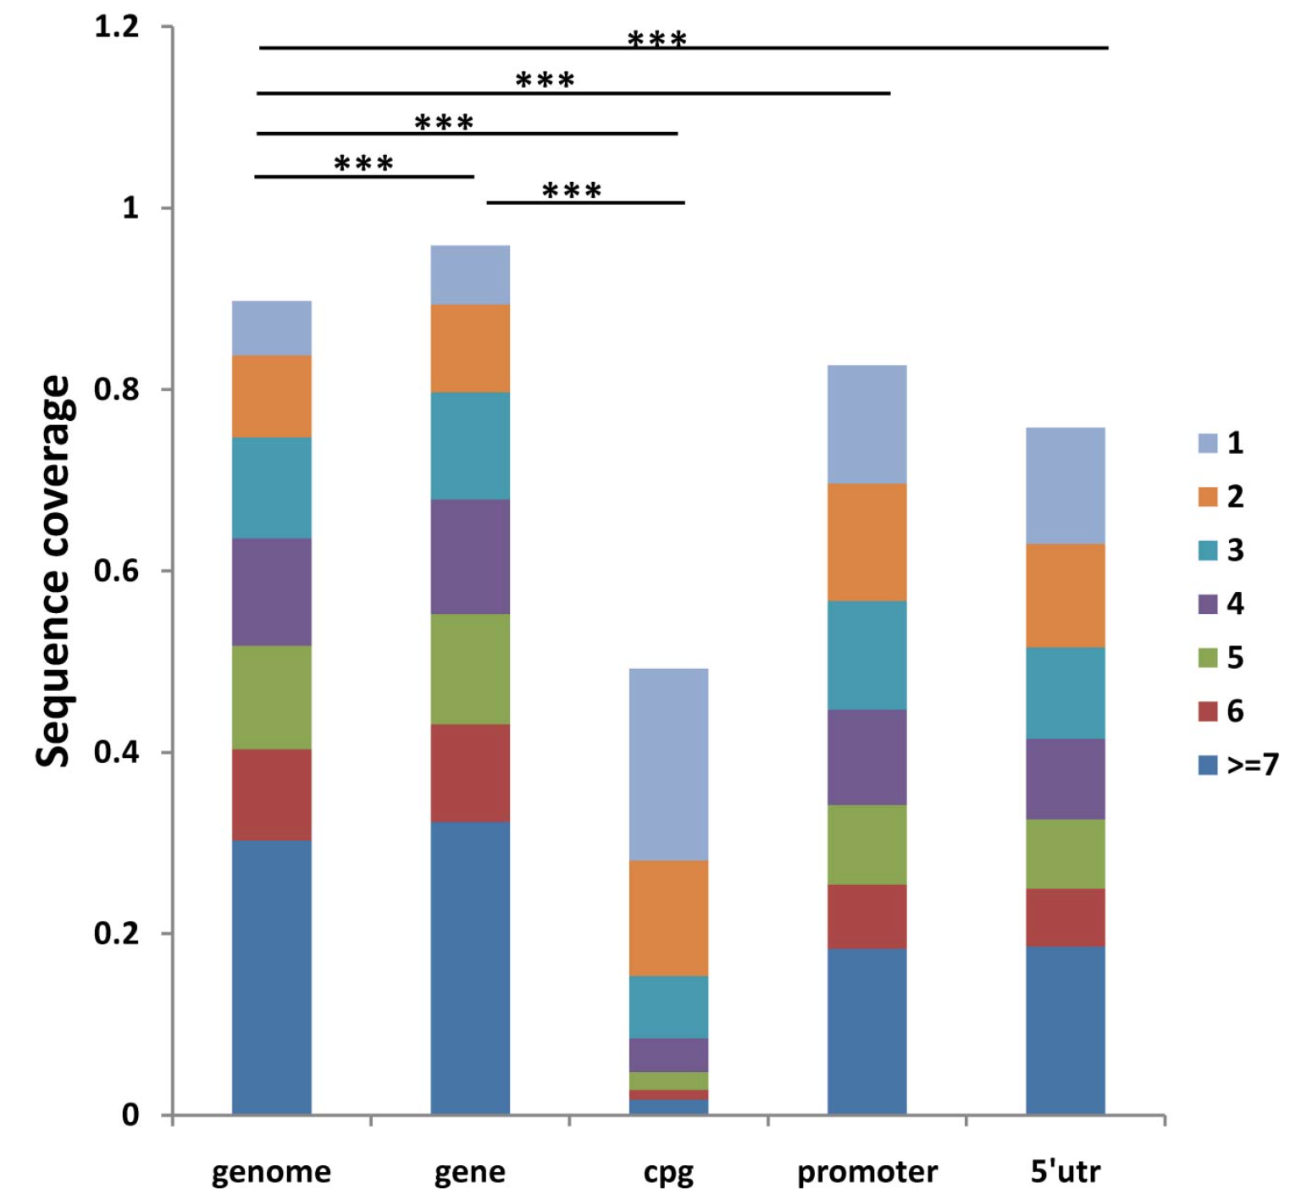

Slide 20
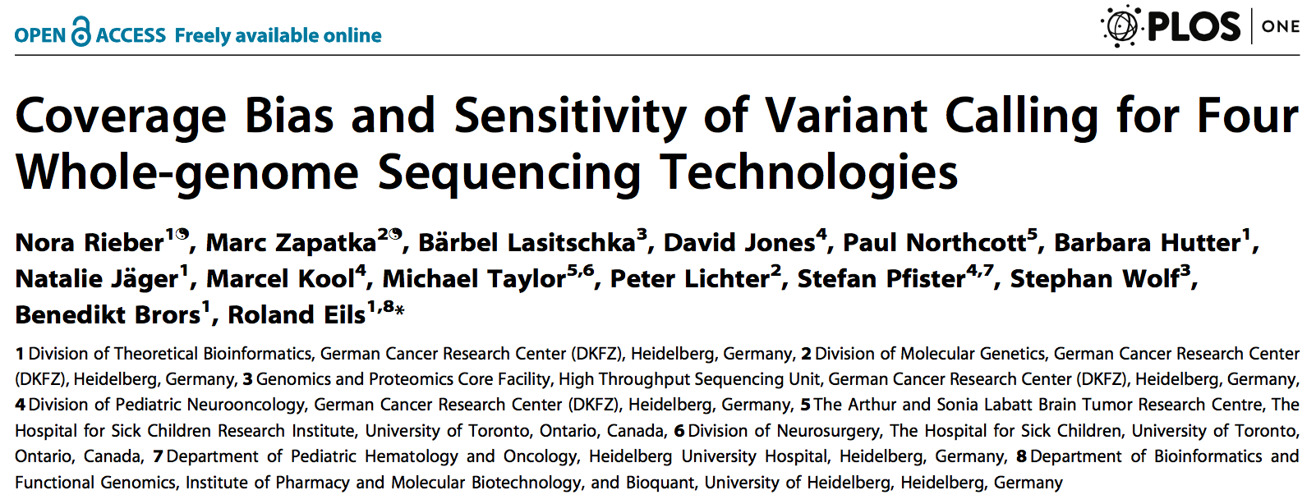
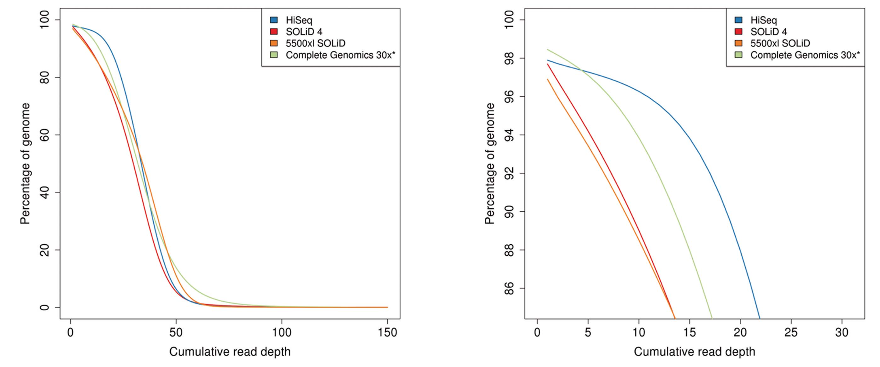

Slide 21
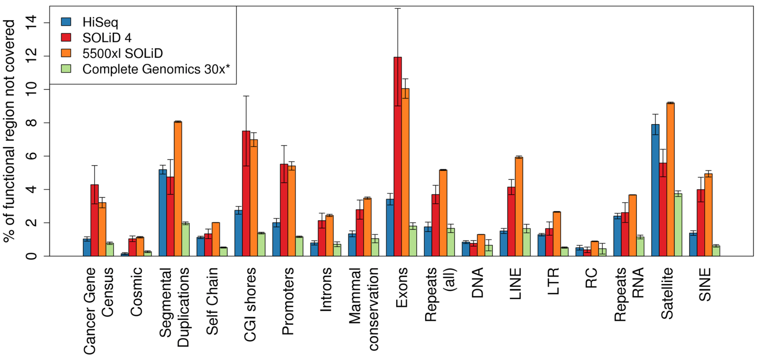

Slide 22
1000 Genomes – phase 1
Phase 1: low coverage and exome data analysis
Results of phase 1 published in late 2012
14 populations, 1092 individuals

Slide 23
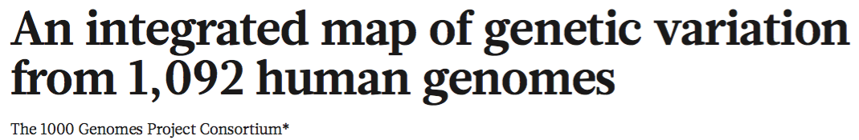
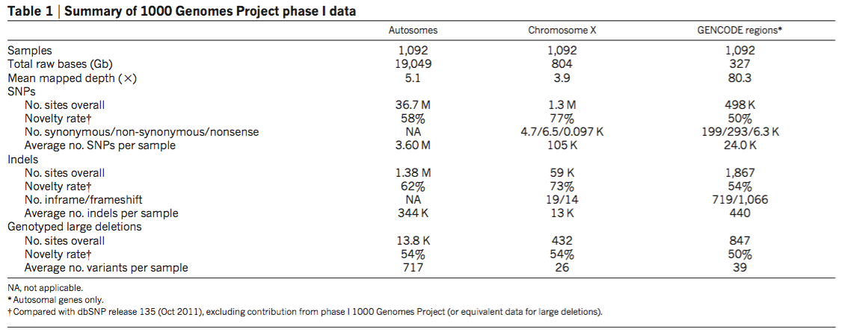
Notes:
Don’t know why NA for autosomes for synonymous/ etc

Slide 24
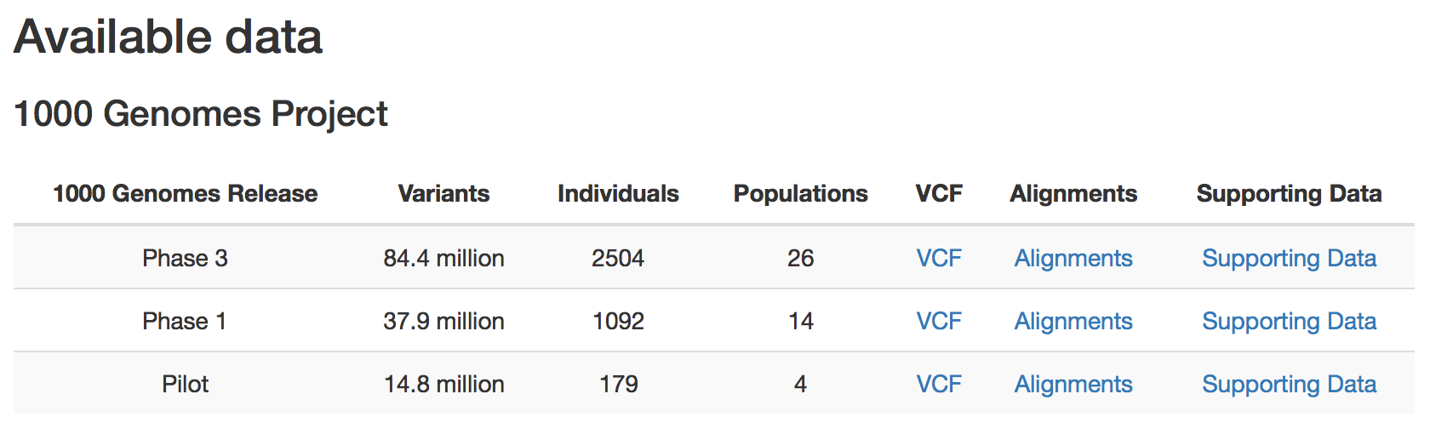
1000 Genomes – phase 3
Data available at the “end” of the 1000 Genomes project (2015):
http://www.1000genomes.org/data

Slide 25
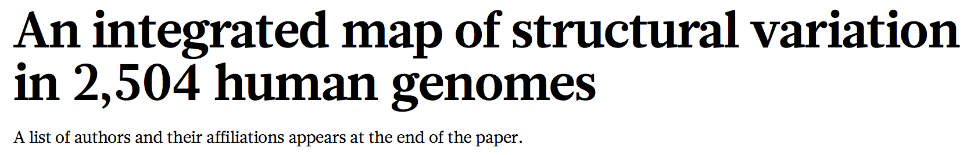
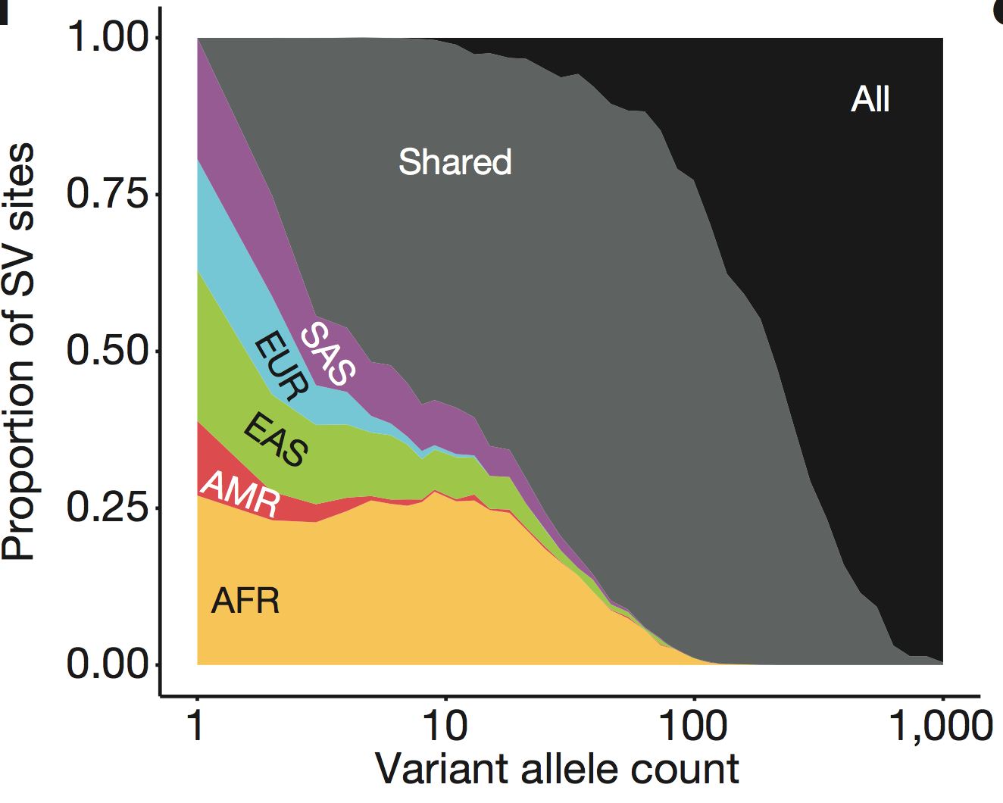
Notes:
X axis is (I think) the number of individuals with a variant allele out of 2,504

Slide 26
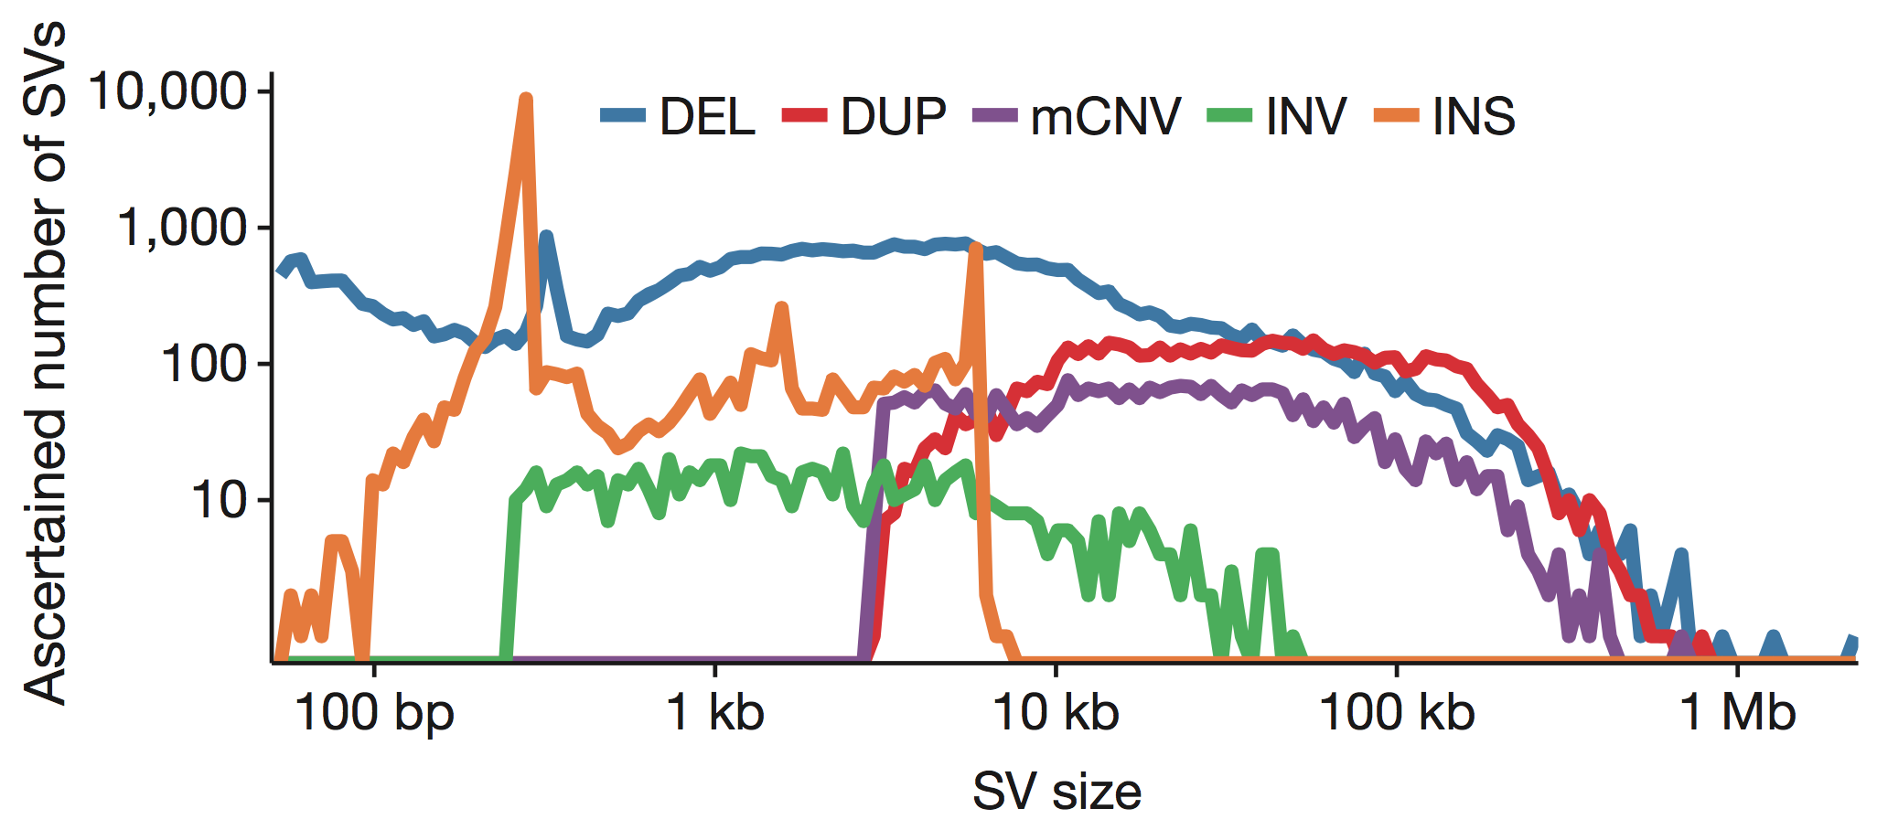

Slide 27
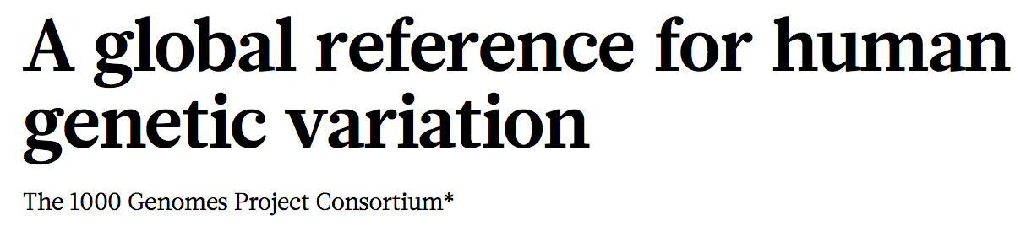
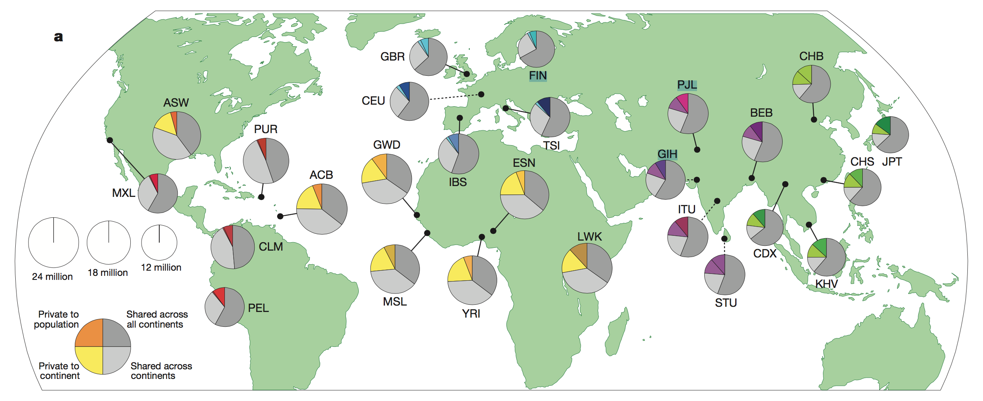

Slide 28
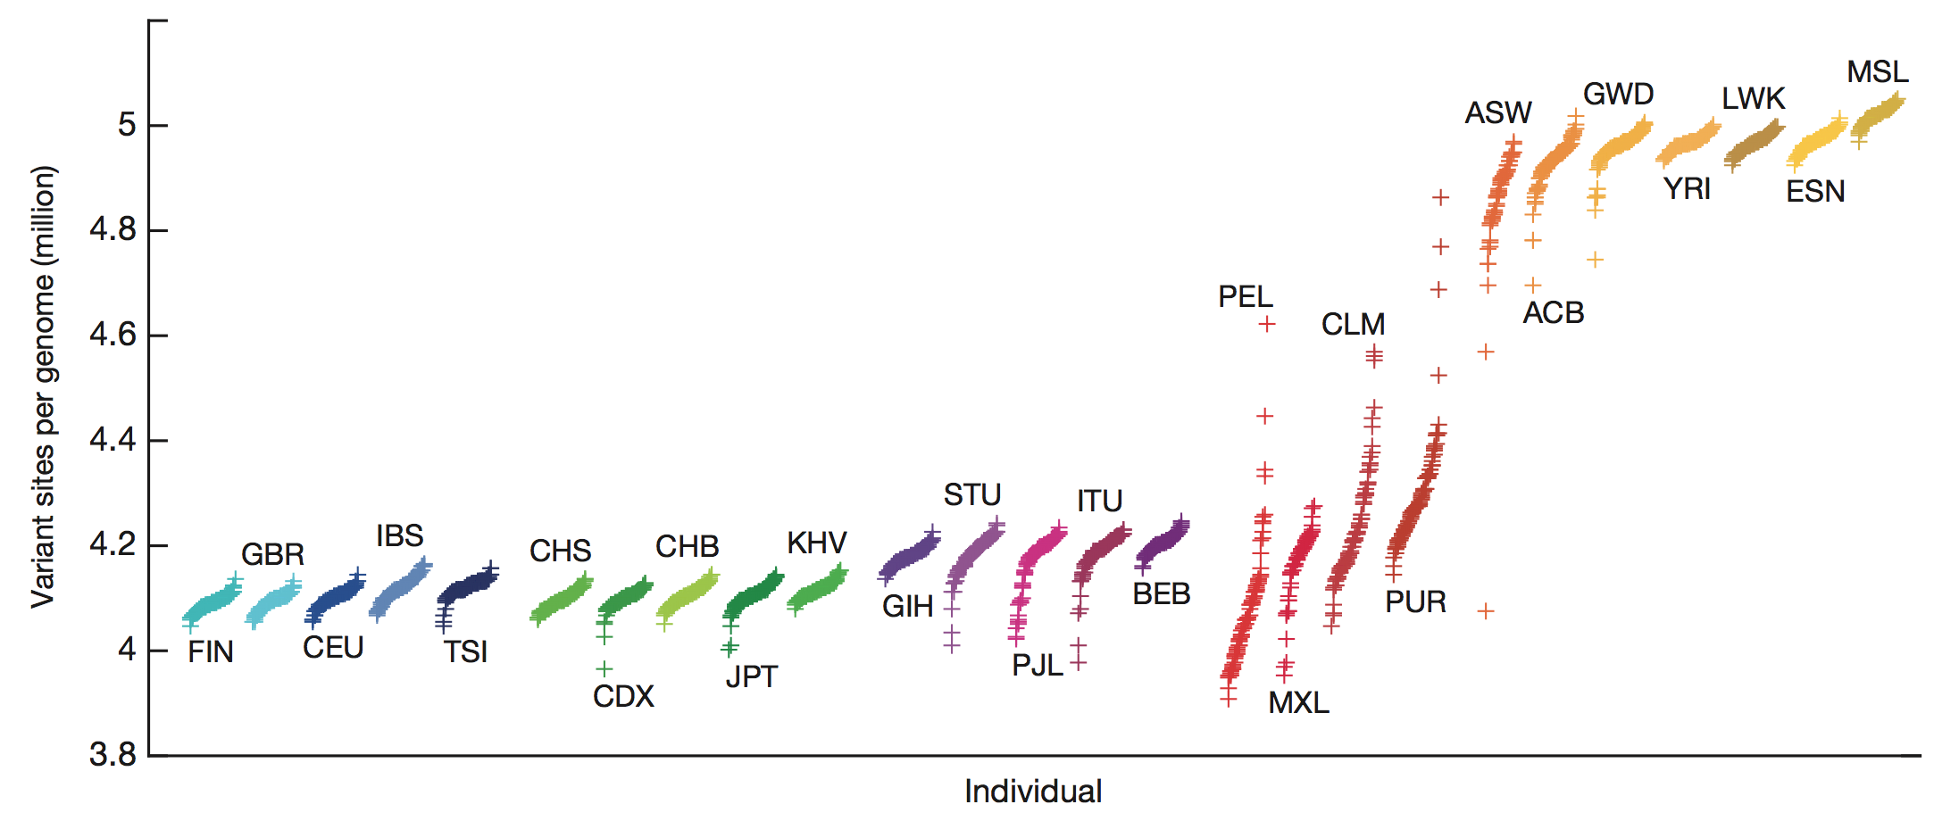

Slide 29
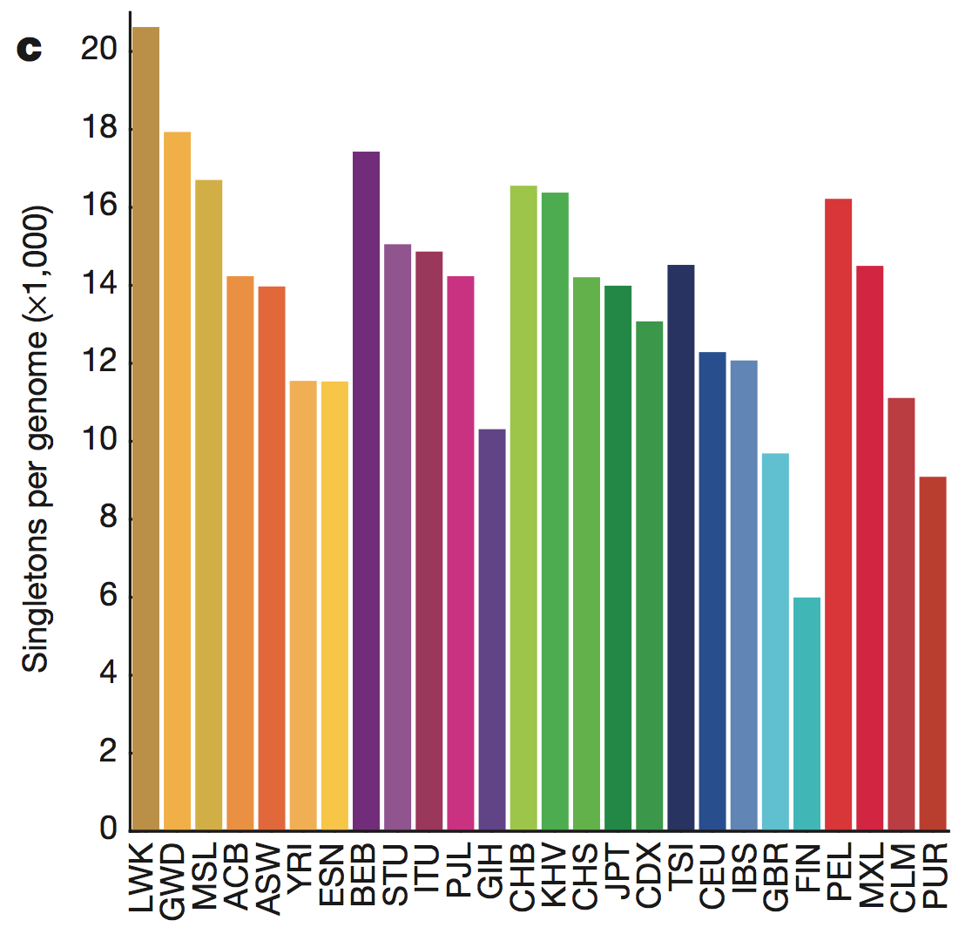

Slide 30
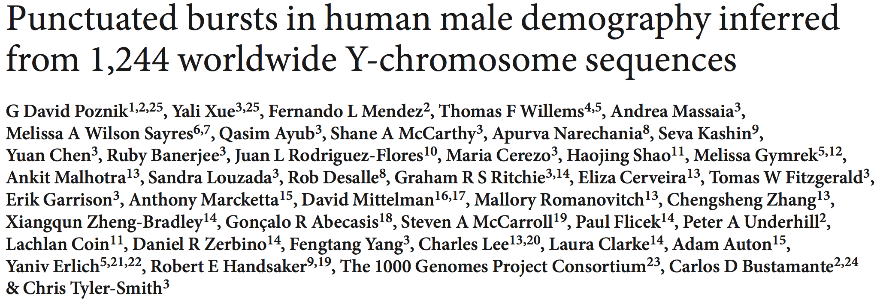
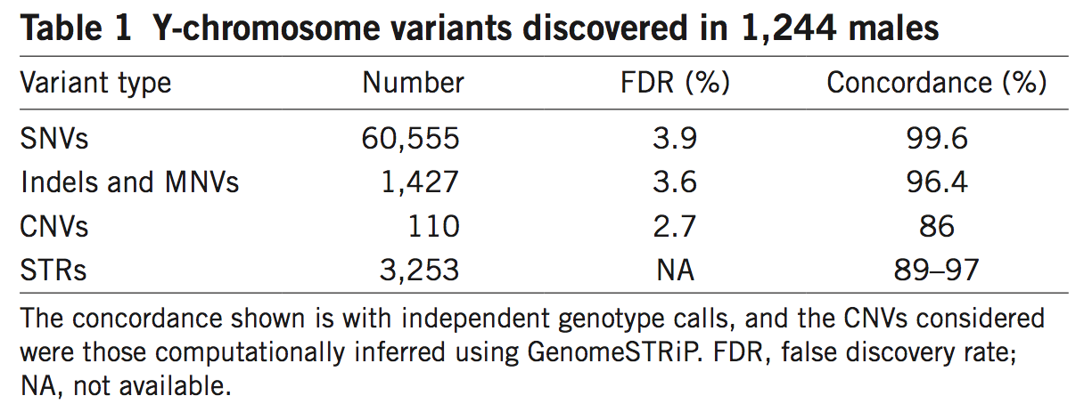
Notes:
multiple-nucleotide variants (MNVs)
We report the sequences of ,244 human Y chromosomes randomly ascertained from 26 worldwide populations by the 000 Genomes Project. We discovered more than 65,000 variants, including single-nucleotide variants, multiple-nucleotide variants, insertions and deletions, short tandem repeats, and copy number variants. Of these, copy number variants contribute the greatest predicted functional impact. We constructed a calibrated phylogenetic tree on the basis of binary single-nucleotide variants and projected the more complex variants onto it, estimating the number of mutations for each class. Our phylogeny shows bursts of extreme expansion in male numbers that have occurred independently among each of the five continental superpopulations examined, at times of known migrations and technological innovations.

Slide 31
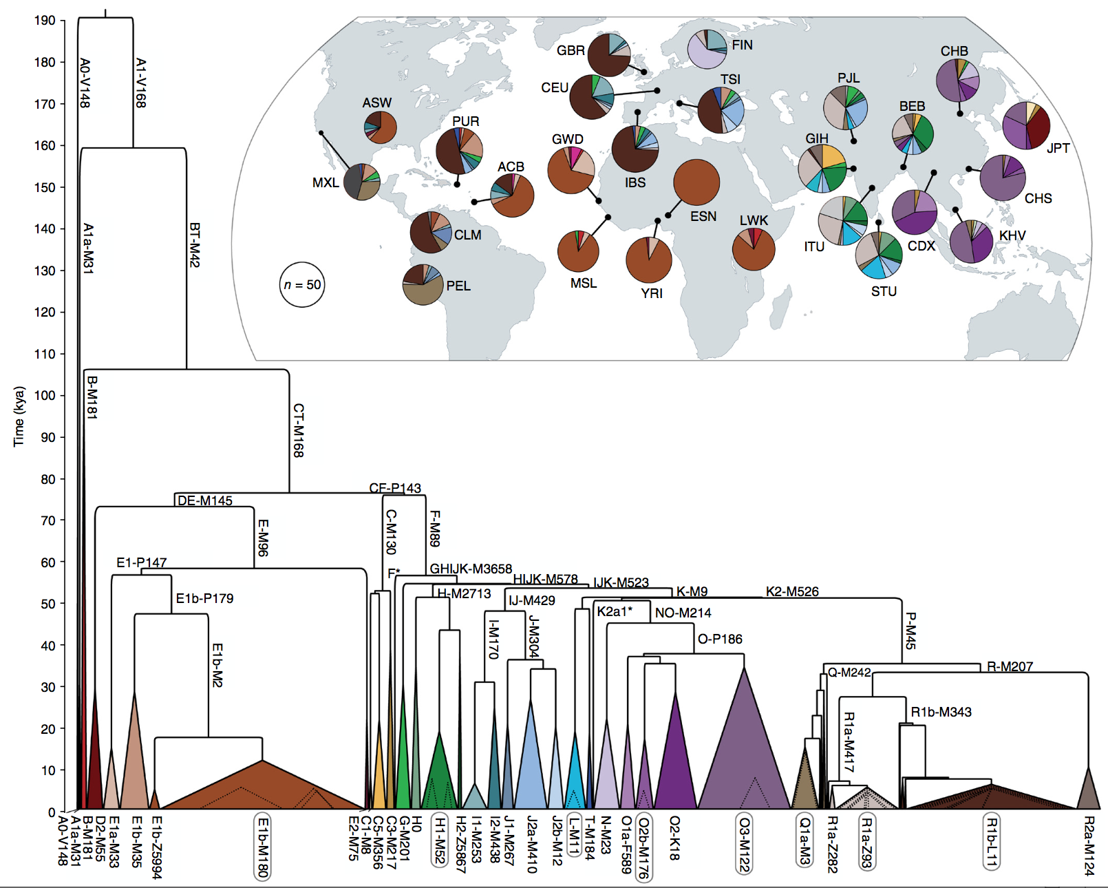
Notes:
Figure 2 Y-chromosome phylogeny and haplogroup distribution. Branch lengths are drawn proportional to the estimated times between successive splits, with the most ancient division occurring ~190 kya. Colored triangles represent the major clades, and the width of each base is proportional to one less than the corresponding sample size. We modeled expansions within eight of the major haplogroups (circled) (Fig. 4); dotted triangles represent the ages and sample sizes of the expanding lineages. Inset, world map indicating, for each of the 26 populations, the geographic source, sample size, and haplogroup distribution.

Slide 32
Additional topics
Population diversity
Clear differences in SNP and SNV genotypes between populations
Strong evidence of intra-population variation (e.g., Y-chromosome study).
Admixture
Populations are not homogenous, and “declared ancestry” may not reflect the underlying genetics.
“Blended” genomes for individuals of mixed ancestry

Slide 33

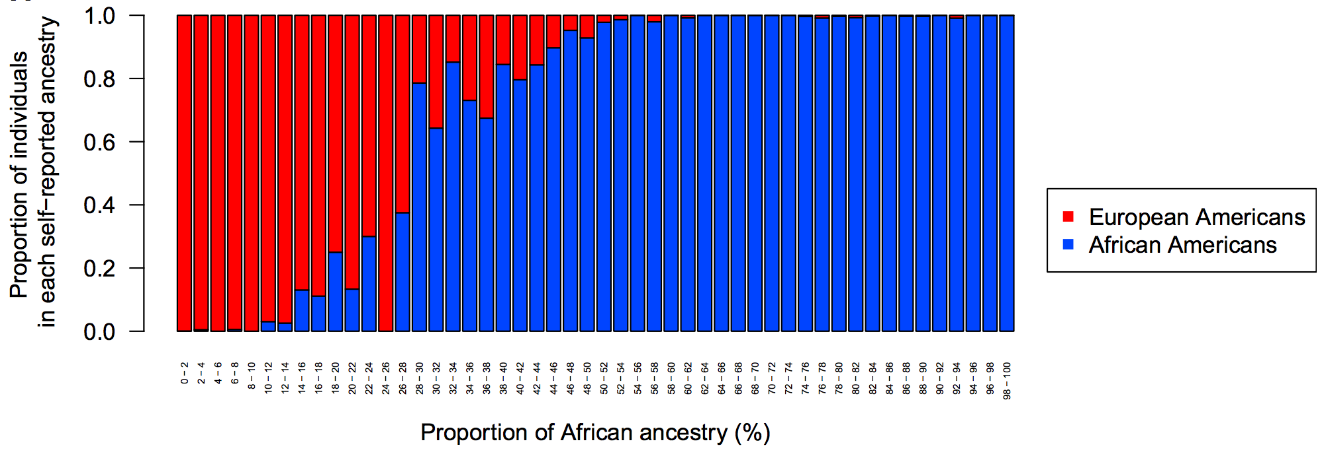

Slide 34
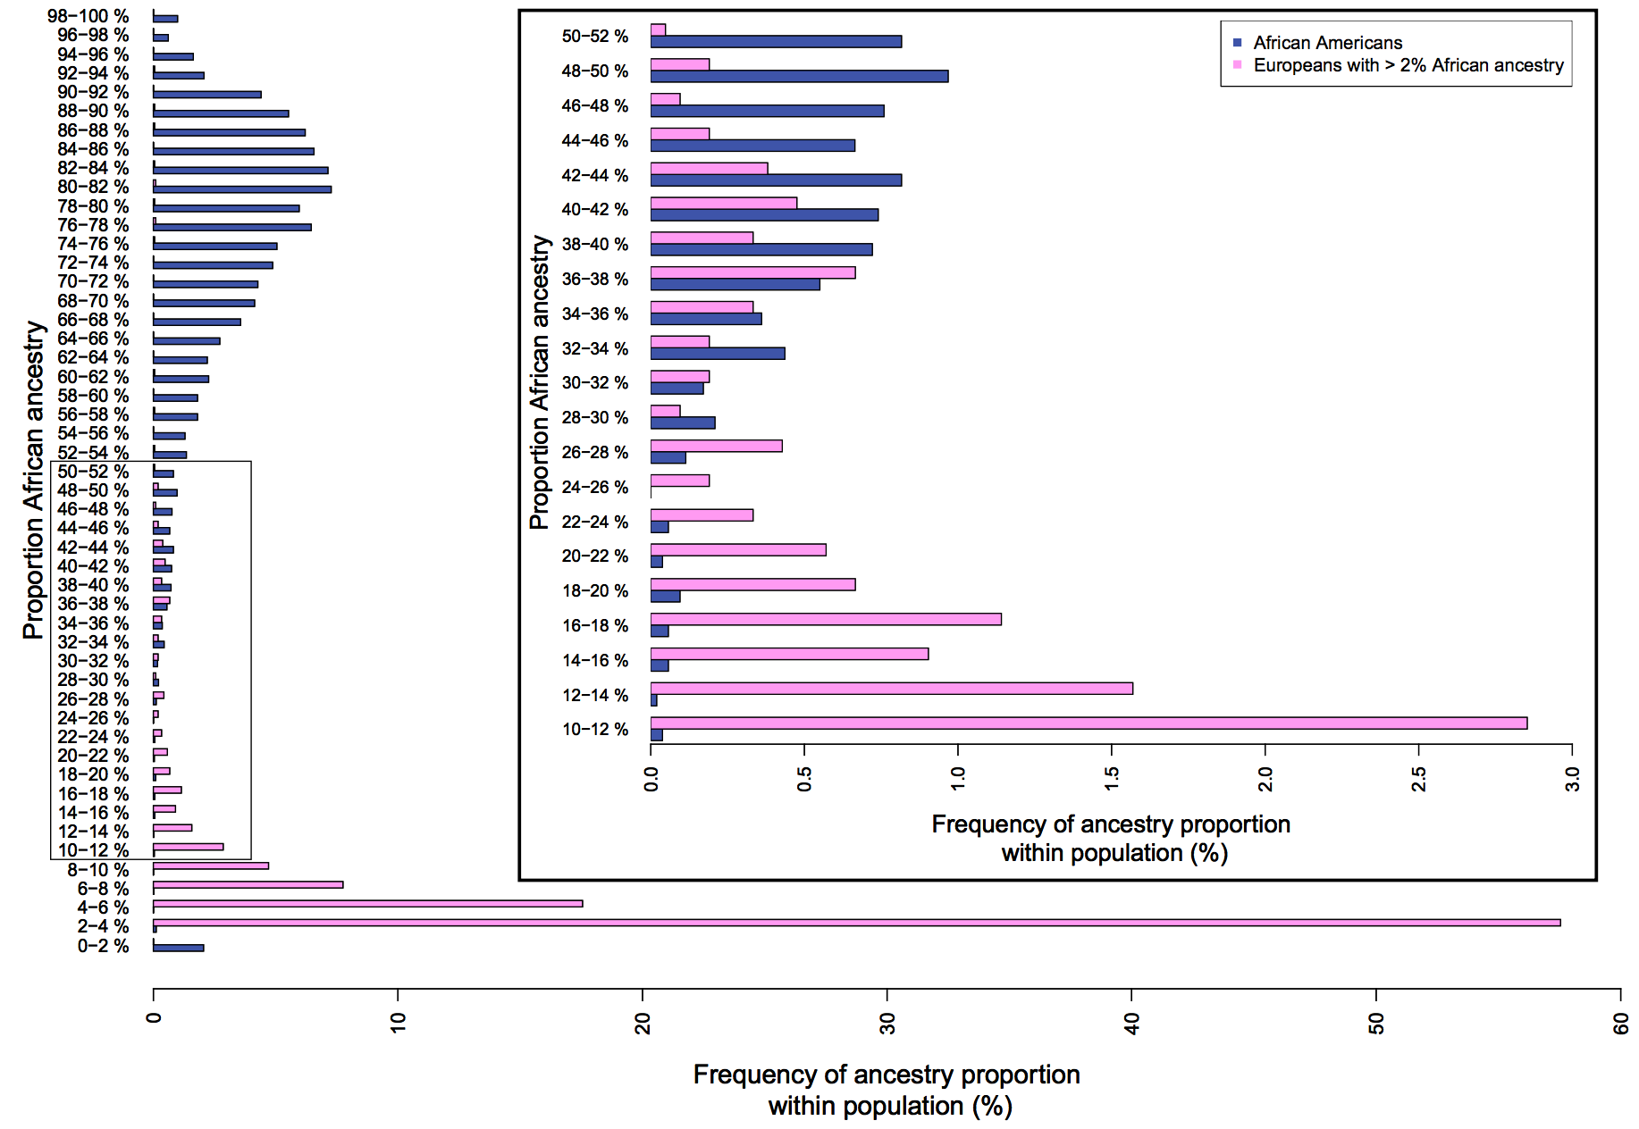

Slide 35
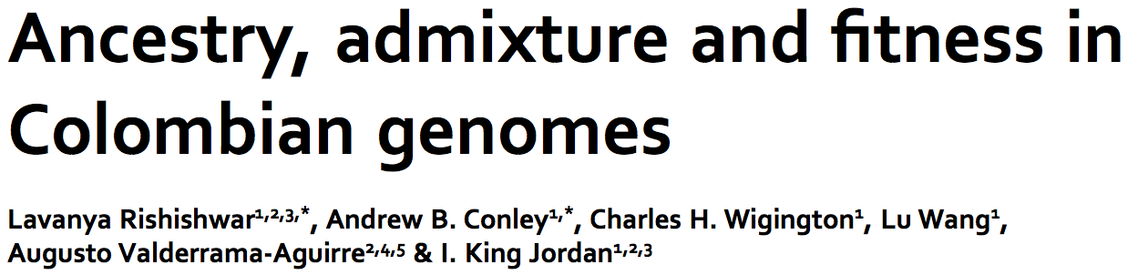
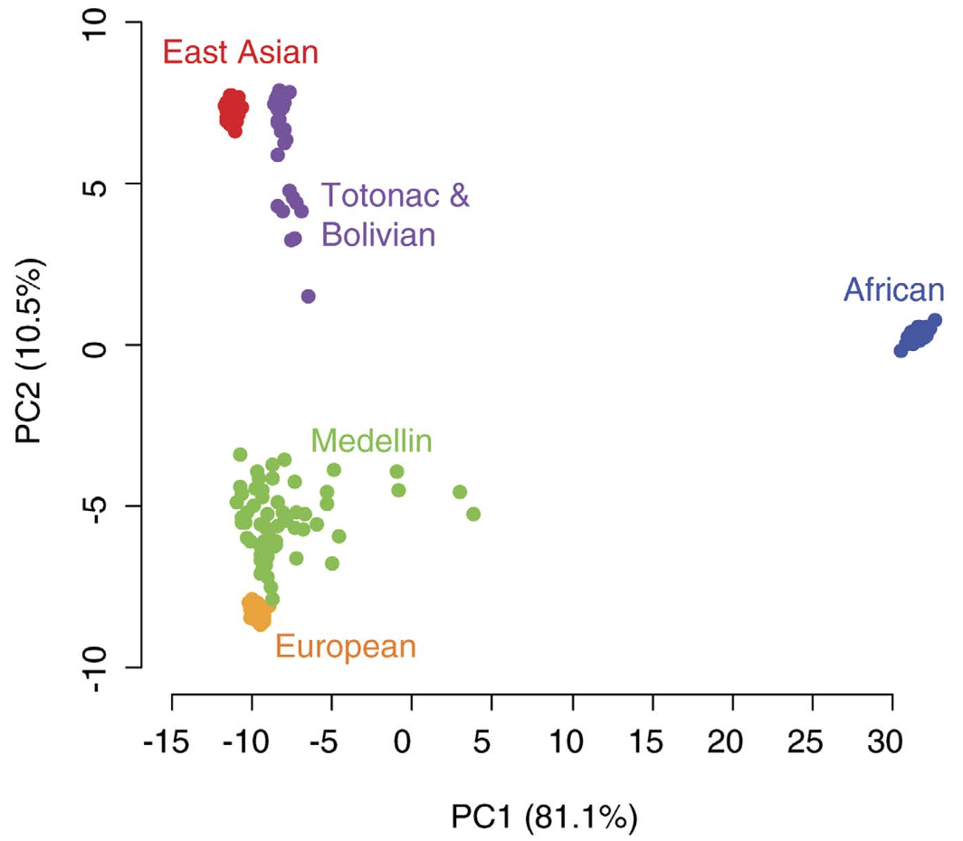
Principle components analysis (PCA) often used to investigate population structure and relatedness
Admixture shows up as a “spread” of points in the PCA plot.

Slide 36
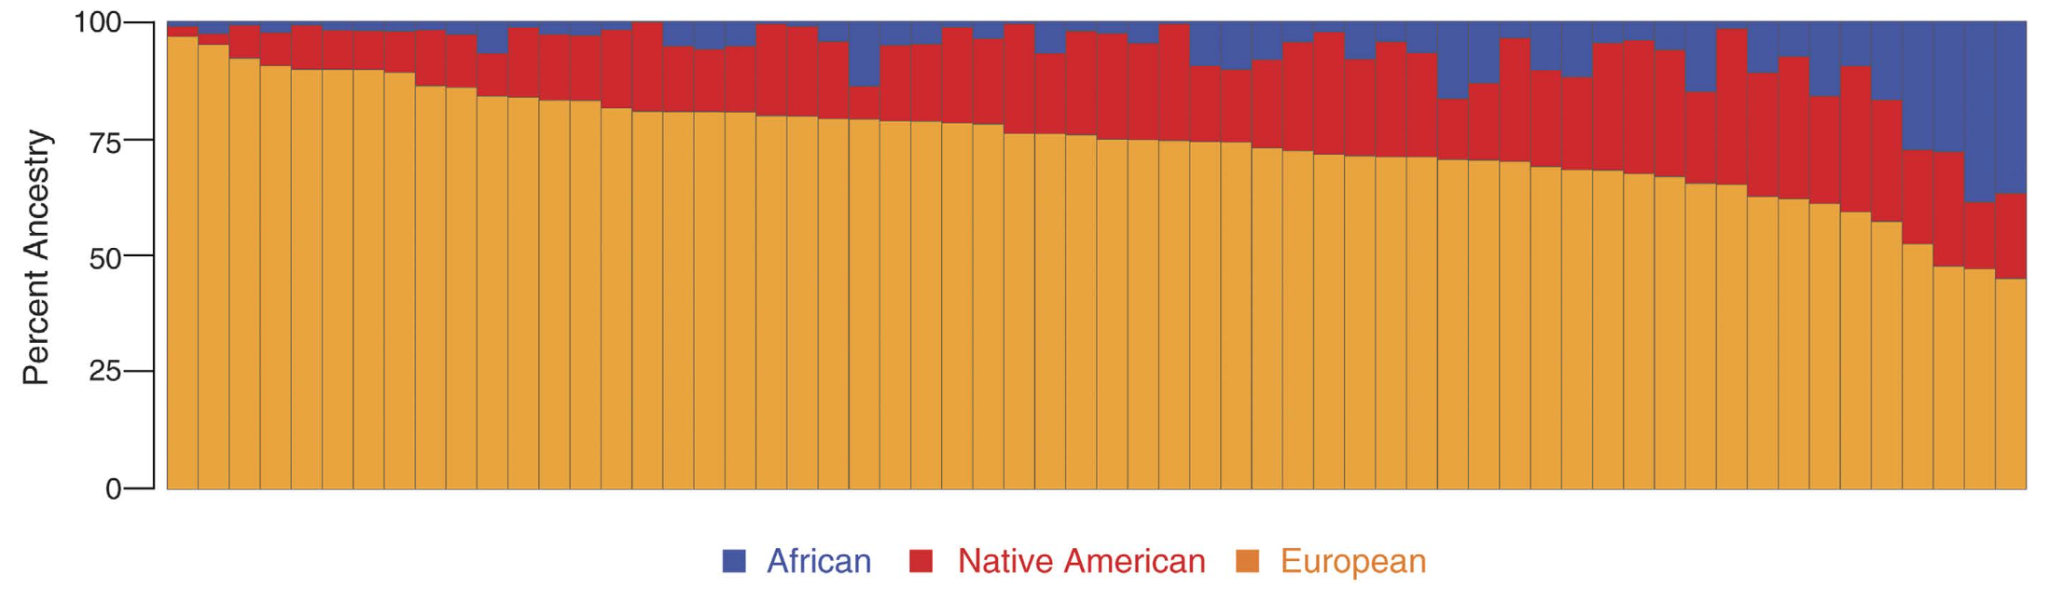

Slide 37
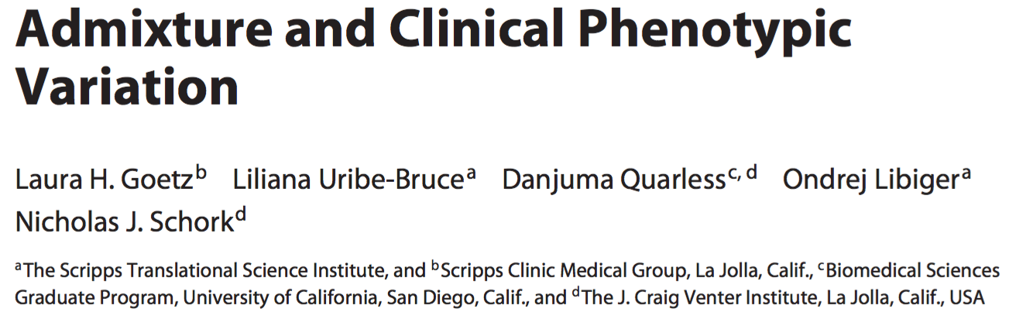

This paper provides extensive summary of how admixture modifies disease risk:
Metabolic disease
Cardiovascular disease
Pulmonary disease
Cancer
Need to take population diversity and admixture into account in human disease studies

Slide 38
Summary
1000 Genomes Project has provided valuable insights into genetic variation and population diversity
Data generation and analysis has helped up-skill and inform the genomics community
Data availability has helped to maximize the value of the project.

Slide 39
Next week
Bring laptops with R and RStudio installed
R: https://cran.rstudio.com/
RStudio:
https://www.rstudio.com/product/rstudio/download/
Who doesn’t have a laptop to bring along?
What will we be doing?
1000 Genomes Project data
Population diversity
Admixture

